Slide 1
Book recommendation system

Slide 2
Data set Over View
1. Dataset Overview
DF1 (Basic Features): 6,368 books
Columns: Book Name, Author, Rating, Number of Reviews, Price
DF2 (Advanced Features): 4,464 books
Adds Description, Listening Time, and Ranks and Genre
Key talking point: DF2 contains more detailed metadata but fewer books — possible subset with richer data.

Slide 3
Data Cleaning & Merge
Text normalization applied to Book Name and Author:
Lowercased text
Removed leading/trailing spaces
Handled missing values
Purpose:
Ensure accurate matching despite formatting differences
Reduce duplicate or missed matches
Merge results:
Rows increased to 7,576 (outer merge keeps unmatched books)
Nulls:
Book Name & Author: 749 (unmatched rows)
Number of Reviews: 744
Price: 2 (almost complete)
Description, Listening Time, Ranks and Genre: ~2,568 (only in advanced dataset)
Data cleaning steps after merge:
Dropped rows with missing titles/authors → 6,827 rows
Deduplicated by normalized Book Name + Author → 5,402 unique books
Converted listening time to minutes (zeros where unavailable)
Extracted genres as lists (some empty)
Final cleaned dataset saved as: cleaned_books.parquet

Slide 4
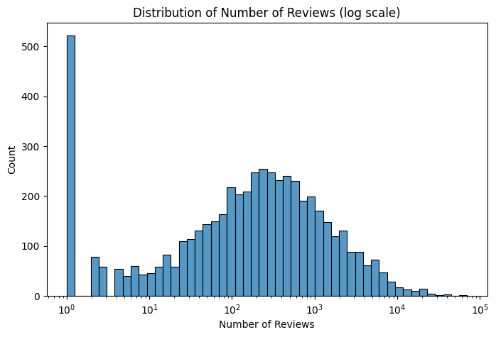
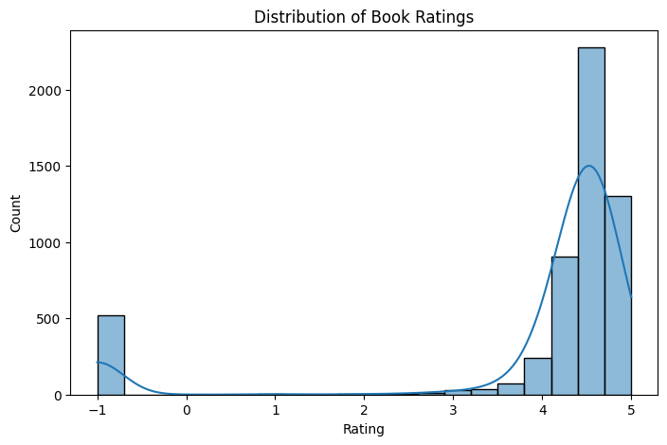
Distribution of Book Ratings
Distribution of Book Ratings
Review counts show many books with few reviews and a long tail of popular books with thousands of reviews.
Most ratings cluster between 4 and 5 stars, indicating generally high user satisfaction. A small peak near -1 likely represents missing or placeholder ratings.

Slide 5
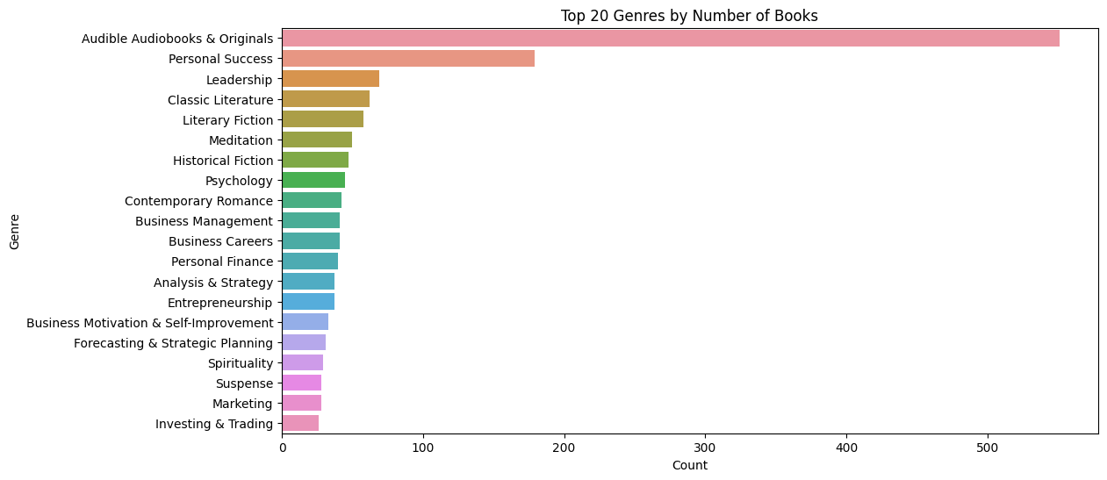
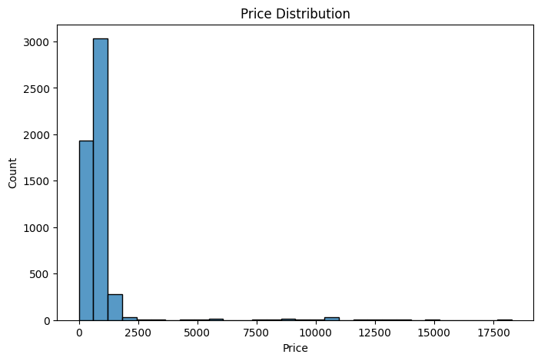
Distribution of Price
Top 20 Genres by Number of Books
Prices are heavily skewed toward the lower end (0–1,000 ₹), with a few high-priced outliers. Most audiobooks are affordable, reflecting diverse pricing strategies.
“Audible Audiobooks & Originals” and “Personal Success” dominate the catalog, suggesting strong demand for these genres.

Slide 6
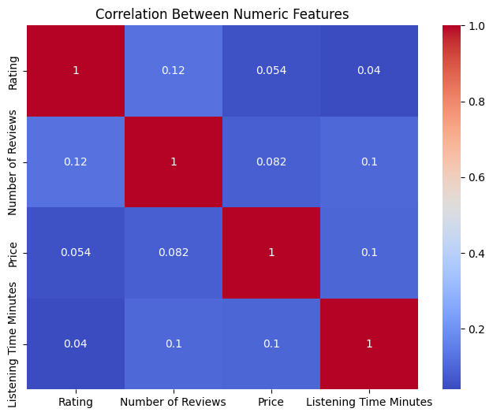
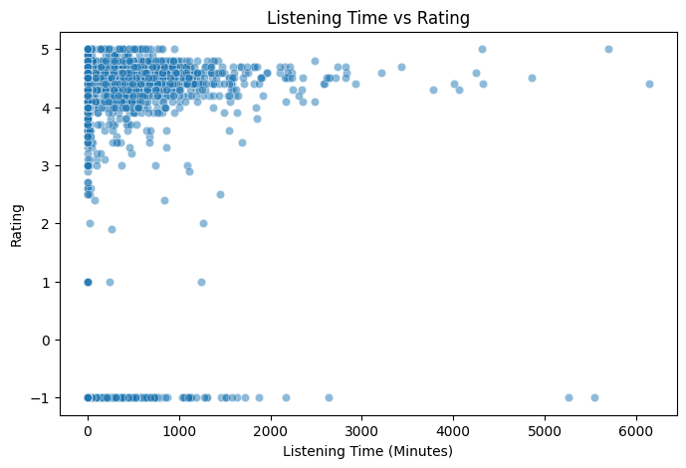
Correlation Between Numeric Features
Listening Time vs. Rating
Scatter plot reveals no clear relationship between audiobook length and rating. High ratings are distributed across all listening durations, confirming diverse user preferences.
Numeric features like Rating, Number of Reviews, Price, and Listening Time show near-zero linear correlations, indicating they vary independently. For example, higher price does not guarantee higher rating.

Slide 7
Cluster summary and insights
Cluster | Number of Books | Top Genres (with counts) | Theme / Insight | Use Case
0 | 279 | Audible Audiobooks & Originals (279), Hinduism (15), Classic Literature (13), Meditation (13), Biographies (13) | Spirituality, meditation, self-help classics | Mindfulness, spiritual growth
1 | 2967 | Contemporary Romance (25), Literary Fiction (24), Meditation (24), Classic Literature (23), Historical Fiction (19) | Large diverse cluster with fiction & some meditation | General/popular books recommendation
2 | 362 | (No strong dominant genres) | Mixed/niche cluster, eclectic collection | Readers wanting variety
3 | 656 | (Diverse: biographies, history, literary fiction) | Historical, biographical, literary nonfiction | History and biography enthusiasts
4 | 51 | Personal Success (6), Audible Audiobooks & Originals (5), Fiction Classics for Children (4), Fairy Tales (3) | Children's classics and beginner self-help | Families, children's literature
5 | 52 | Leadership (52), Business Management (12), Forecasting & Strategic Planning (8) | Business, leadership, management focused | Professional development
6 | 22 | Audible Audiobooks & Originals (22), Analysis & Strategy (22), Investing & Trading (6), Stocks (5) | Investing, finance, trading | Investors and finance enthusiasts
7 | 81 | Personal Success (81), Meditation (4), Self-Esteem (4), New Thought Spirituality (3) | Personal success and spirituality | Self-help and sp

